Slide 1
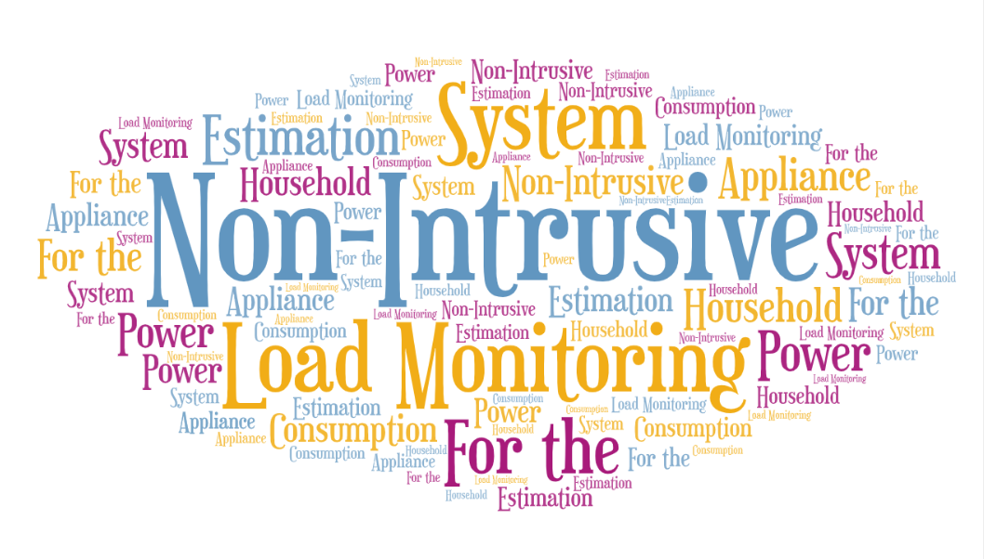

Slide 2


Mini Project By:
KIRAN D(18BEC022)
NIKHIL S A(18BEC033)
NITHIN R(18BEC034)
P. BHANU PRAKASH(18BEC035)
Project Guide: Dr. Prakash Pawar

Slide 3
Contents:
Load monitoring.
Need for load monitoring.
Why it matters?
Types of load monitoring.
Intrusive load monitoring(ILM).
Direct Intrusive load monitoring(DILM).
Indirect Intrusive load monitoring(IILM).
Non-Intrusive load monitoring(NILM).
General framework of NILM.
Classification of Domestic appliances.
Data Acquisition.
Feature extraction.
About the REDD dataset.

Slide 4
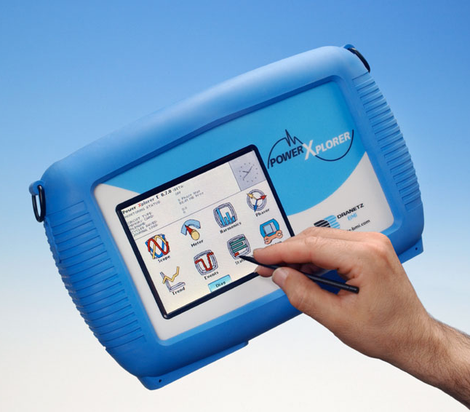
What is Load Monitoring :
Load monitoring and identification is a method of determining electrical energy consumption and operation condition of individual appliances based on the analysis of composite load measured from the main power meter of the building.
They can supply information such as type of load, electricity, and consumption details and running conditions of the appliances to both customer and utility.

Slide 5

Need For Load Monitoring :
Energy conservation is a challenging issue.
Goal of load monitoring is to perform detailed energy sensing and to provide information on the energy spent.
It can be used to formulate load plan strategies for optimal energy utilization.
Appliance Load Monitoring (ALM) leads to identification of high energy consuming appliances.
Reduction in energy wastage can be achieved through monitoring of energy consumption and relaying of this information back to customers.

Slide 6

Improve relationship with customers
To understand bills
Plan your monthly
budget
Be able to make a financial decision for when to use a appliance.

Slide 7
Types Of Load Monitoring :
Load Monitoring technique can be generally grouped into two types and they are as follows:
Intrusive Load Monitoring.
a. Direct Intrusive Load Monitoring.
b. Indirect Intrusive Load Monitoring.
Non- Intrusive Load Monitoring.

Slide 8
Intrusive Load Monitoring :
Intrusive load monitoring measures the energy consumption of an appliance by connecting power meter to each appliance in the household.
To adequately monitor appliances sensors are installed at each appliance to be monitored and once the appliance recorder receives a sensor message, it immediately records the load data and delivers them to the data centre for further analysis.
As it requires entering the house, thus the system is referred as intrusive.
Implementation of ILM imposes high costs and complex installation procedures.
ILM provides accurate results.
ILM is further classified into two types and they are as follows: Direct Intrusive Load Monitoring(DILM) and Indirect Intrusive Load Monitoring(IILM).

Slide 9
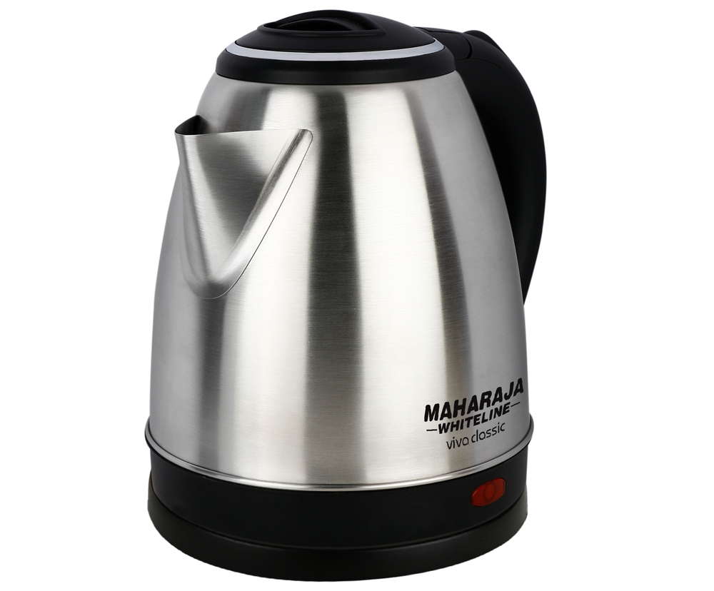
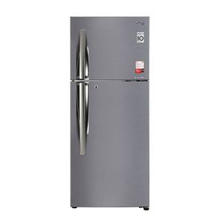
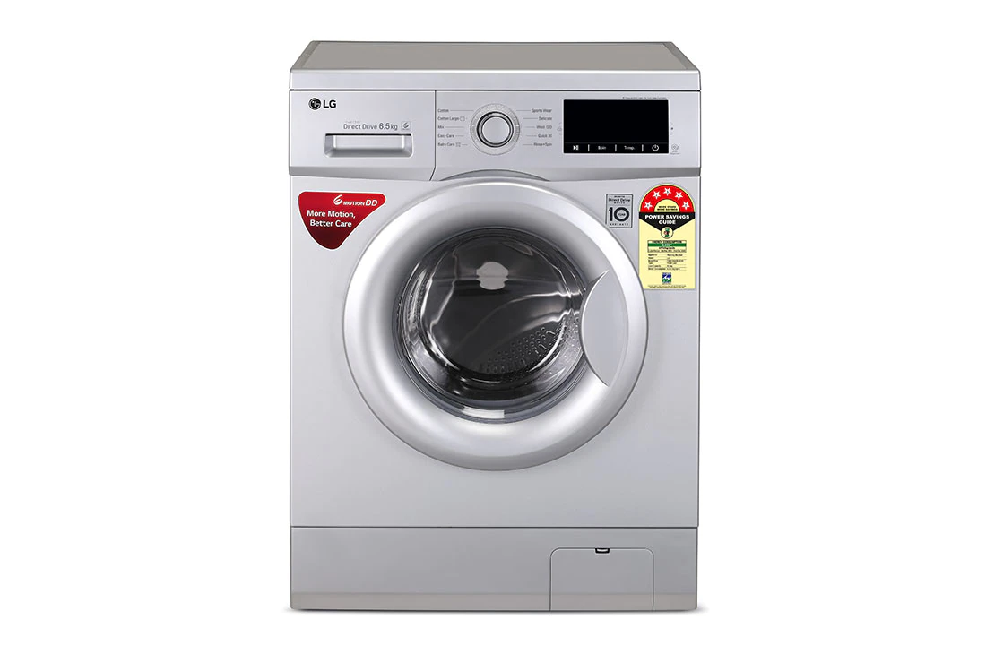
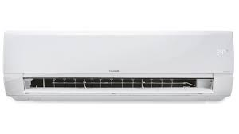
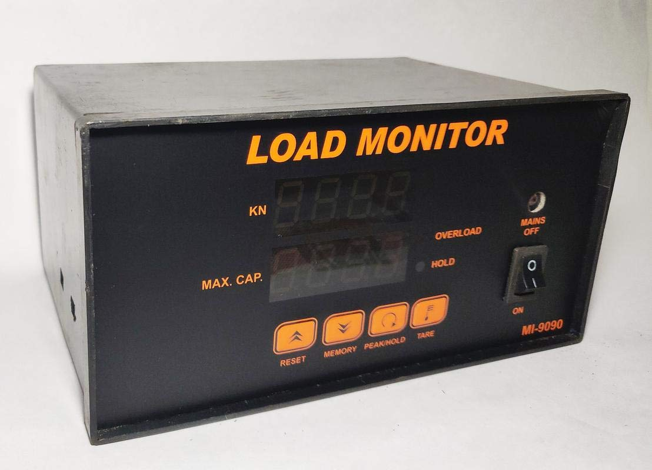
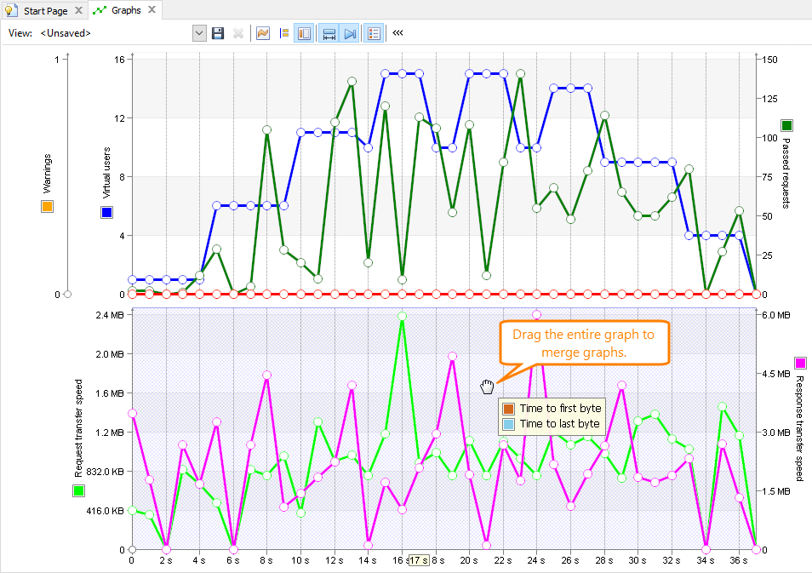
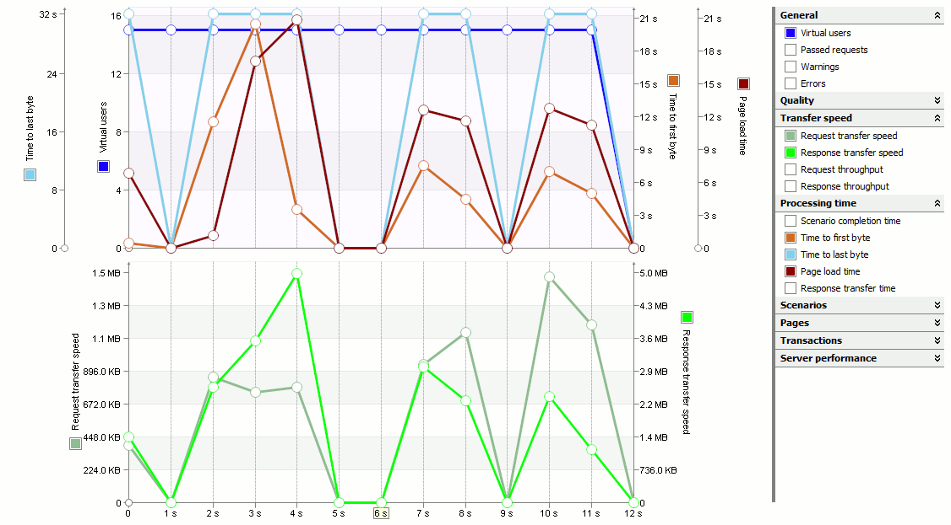
Intrusive Load Monitoring

Slide 10
Direct Intrusive Load Monitoring
(DILM):
Direct ILM is also known as physical intrusive signatures.
The physical intrusive signatures can be generated by a small device attached to the power cord of an appliance for measuring the energy consumption by the appliance.
Whenever the appliance is switched on, the device sends signal to the data collector indicating the operating state of the appliances.
The power drawn by the appliance can be calculated by measuring the electromagnetic field generated by the flow of the current through the wire.

Slide 11
Indirect Intrusive Load Monitoring
(IILM):
IILM technique measures non-electrical characteristics, from which each appliance power demand is inferred.
There are three forms of IILM and they are as follows:
Appliance tagging.
Ambient sensor.
Conditional demand analysis.
Appliance tagging is the modification of smart appliance such that a tag displays a unique signal when the appliance turns on or off.

Slide 12
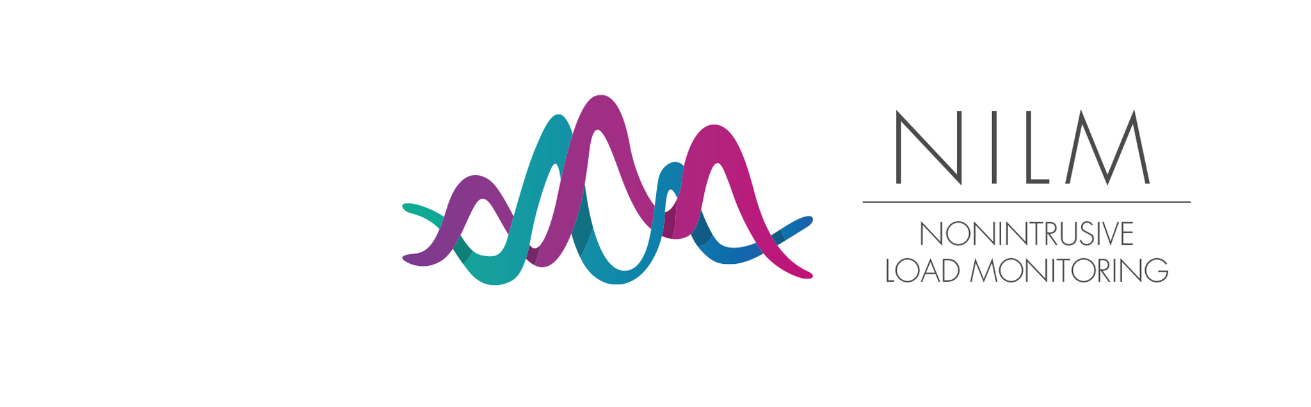

Slide 13
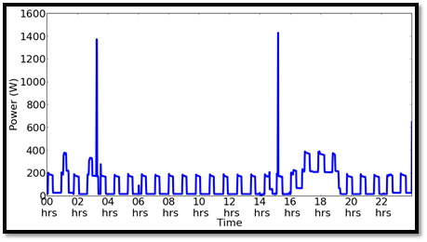
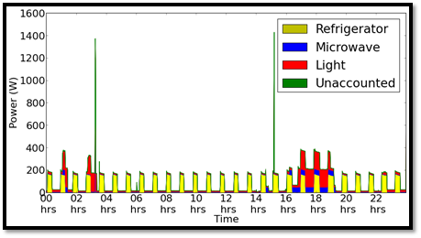
Non-intrusive load monitoring
(Energy disaggregation)
“Process of estimating the energy consumed by individual appliances given just a whole-house power meter reading”

Slide 14
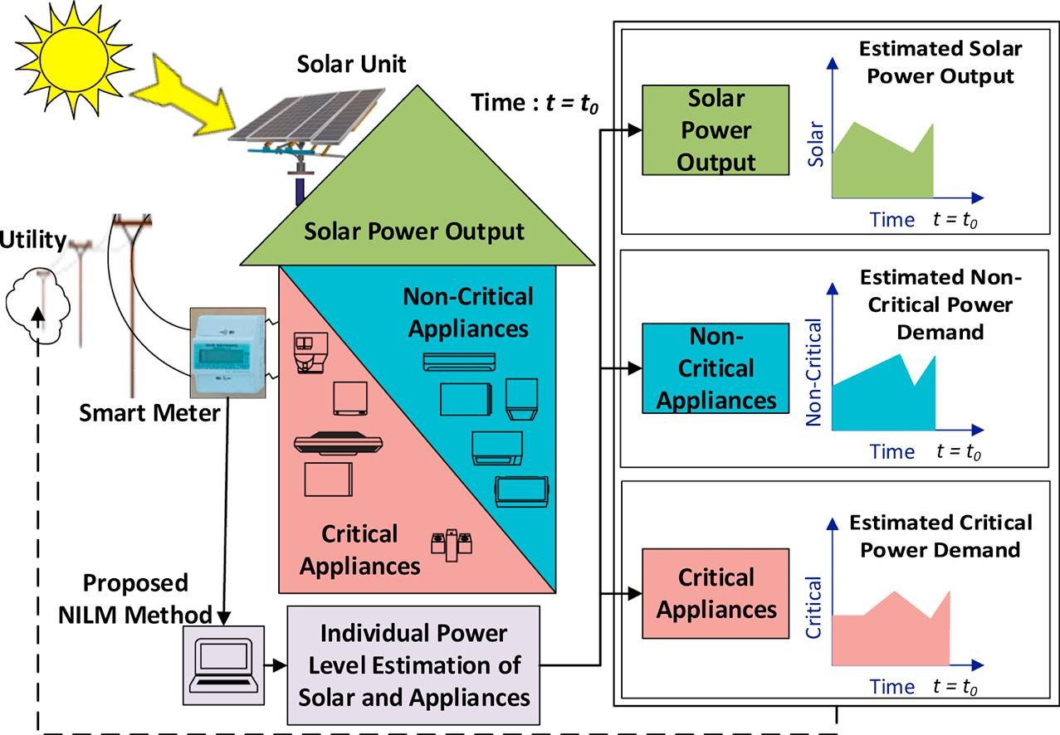

Slide 15
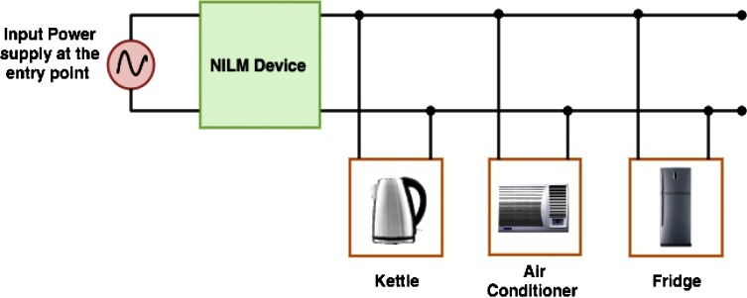
Non-Intrusive Load Monitoring :
NILM is a process of estimating the energy consumed by individual appliance. It requires only single meter per house. The data is acquired from the main electrical panel outside the building, hence considered to be non intrusive.

Slide 16

General Framework of NILM :
Data Acquisition.
Feature Extraction.
Appliance Classification.

Slide 17
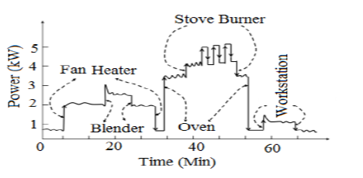
The total aggregated measurement of the household energy consumption of the individual appliance from the main meter can be estimated according the equation:
pₜ = ∑ pᵢ(t) + eₜ
pₜ - aggregate household energy consumption.
pᵢ(t) - is the individual appliance energy consumption at a given period of time t.
eₜ - measurement error and line loss.
Power vs time plot of total appliance data.

Slide 18
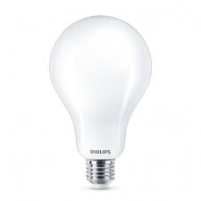
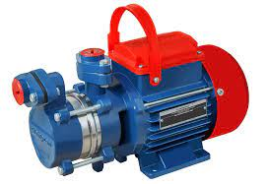
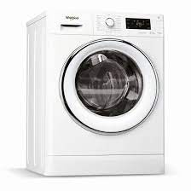
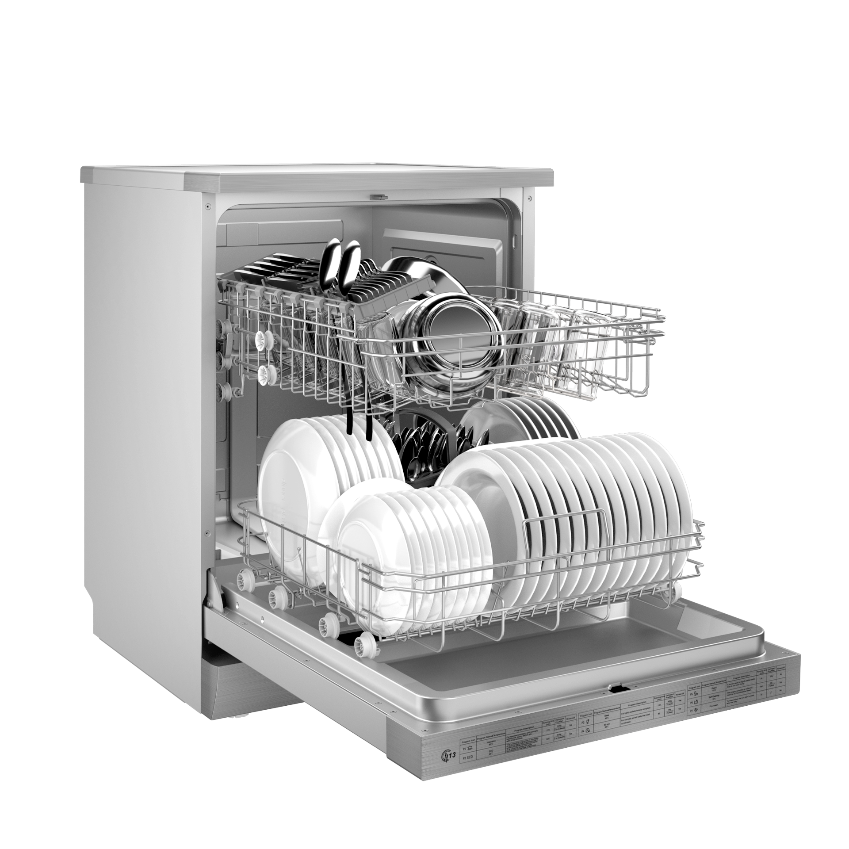
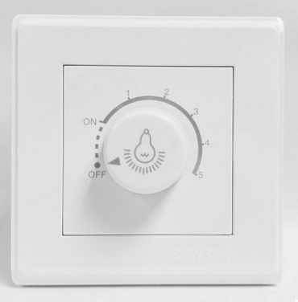
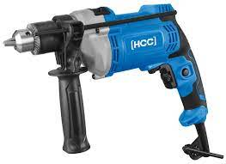
Classification of Domestic appliances:
Based on the operation states and working principles the domestic appliances are classified as follows:
Two-state appliances | Multi-state appliances | Continuously varying power appliances
Appliances which have only two states of operation either ON or OFF. | Appliances that have more than two operating states (ON, OFF, and Stand-by mode).They are also known as FSM. | Appliances that do not consume a constant power, the power consumption varies continuously.
Ex: | Ex: | Ex:

Slide 19
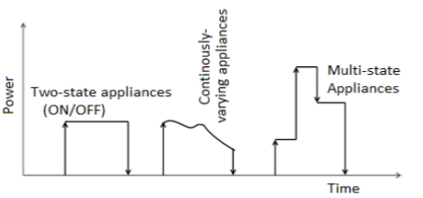
Different Appliances Types Based on their Energy Consumption Pattern

Slide 20
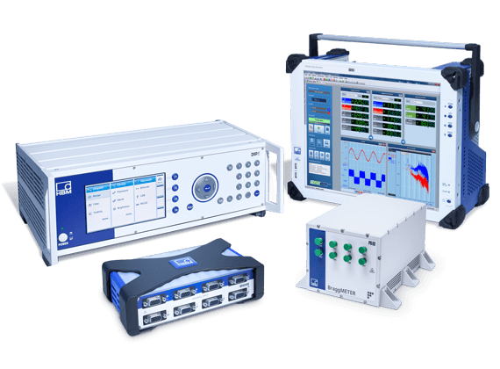
Data Acquisition:
Data acquisition is a stage of obtaining aggregated load measurements from the household at a given time interval.
During this stage, voltage and current measurements are obtained and processed to produce the power metrics.
The steady-state or transient changes in the pre-processed signals, corresponds to the operation of individual appliances.

Slide 21
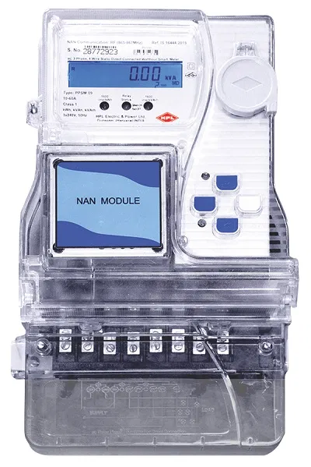
Power meters are used to collect and measure the total household load based on the time interval specified by the researchers.
When an appliance switched ON or OFF, power samples changes and a new steady power level is established.
There are two types of power meters for load acquisition and they are as follows:
Low-frequency energy meters.(KHz)
High-frequency energy meters.(10-100MHz)

Slide 22

Feature Extraction ?

Slide 23
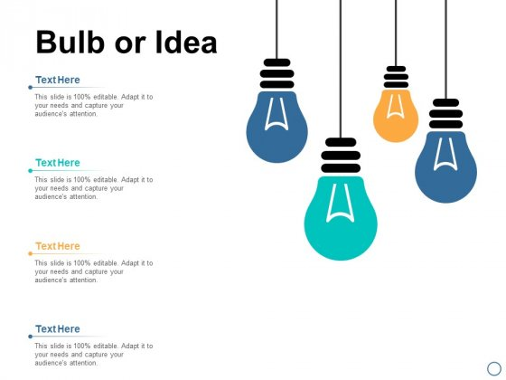
Appliance identification can be made by using an algorithm and comparing the energy consumption of each appliance with known features of a typical appliances in the data.

Slide 24
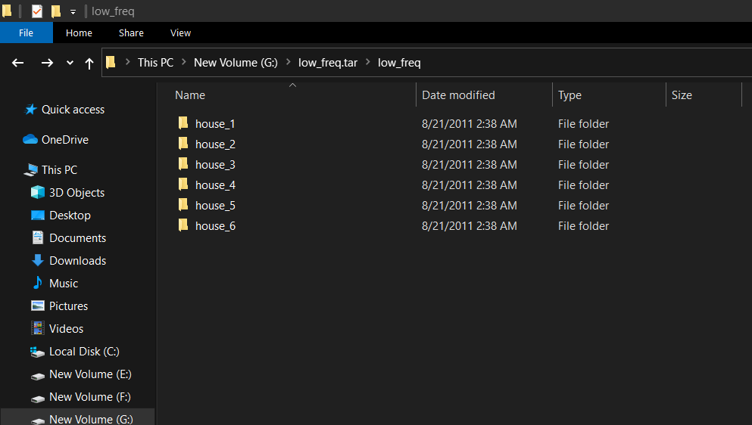
Reference Energy Disaggregation Data Set (REDD):
REDD data-set contains several weeks of power data for 6 different homes.
The directory contains average power readings for the two power mains and the individual circuits of the house.
house_{1..6}-- directories for each house.

Slide 25
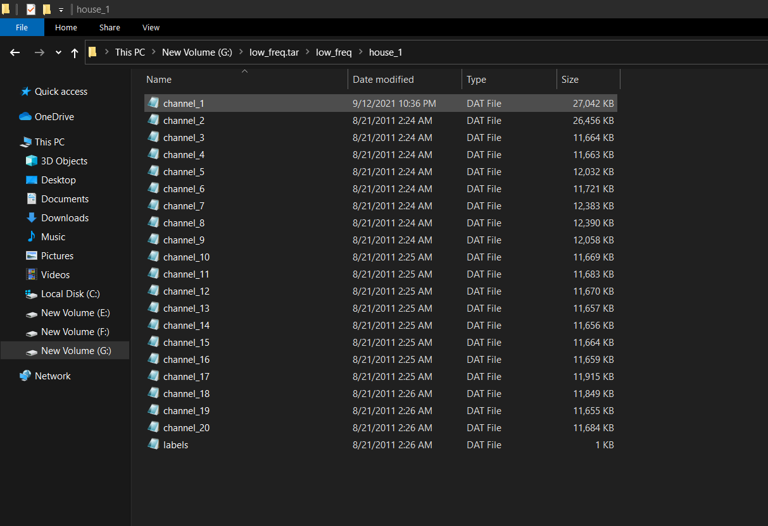
channel_{1..k}.dat -- time and wattage readings for each channel
Each channel_i.dat file contains UTC timestamps (as integers) and power readings.

Slide 26
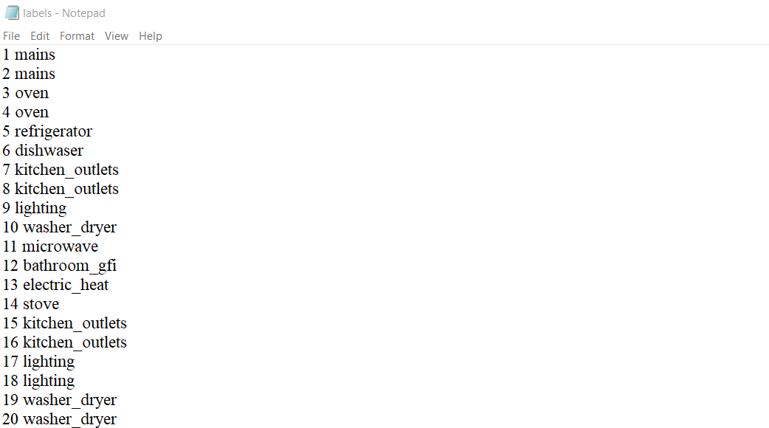
Labels.dat file -- device category labels for every channel.

